Slide 1
Calculating The Unknown Machines Yield Rate
DSP Labs
CSIE

Slide 2
Main Problem
To increase the yield rate of each product, the maintain of the machine condition is a must. When the product yield is decreased, some of the suspected machine (generate too many defect) should be repaired.
Station W
Station X
Station Y
Station Z
Result
Laser Machine
COI Inspection
Sputtering Machine
Leakage Tester
Finished LOT
GBOM C
LOT C5
MS-28
SP-06
LK-13
LOT C5
C5-1
C5-2
C5-3
LOT C6
C6-1
C6-2
LOT C6
GBOM E
LOT E7
LS-29
MS-30
SP-07
C6-3
LK-14
LOT E7
E7-1
E7-2
E7-3
E7-4
F8-2
GBOM F
LOT F8
F8-3
LOT F8
F8-1
latent
Observable
defect pieces
latent
Observable
defect pieces
defect pieces = ??
defect pieces = ??
Main Problem:
While defects on some of the station can’t be observed, which machines are the suspected to have the lowest yield rate or produce highest defect pieces?

Slide 3
Extended Example
Note: ignore the line pattern/dash
‹#›
Station W
Station X
Station Y
Station Z
Result
Laser Machine
COI Inspection
Sputtering Machine
Leakage Tester
Finished LOT
GBOM A
LOT A1
LS-24
LK-06
LOT A1
A1-1
A1-2
LOT A2
A2-1
LOT A2
A2-2
GBOM B
LOT B3
MS-14
LK-12
LOT B3
B3-1
B3-2
GBOM C
LOT C4
C4-1
LOT C4
C4-2
C4-3
LOT C5
MS-28
SP-06
LK-13
LOT C5
C5-1
C5-2
C5-3
LOT C6
C6-1
LOT C6
C6-2
GBOM E
LOT E7
LS-29
MS-30
SP-07
C6-3
LK-14
LOT E7
E7-1
E7-2
E7-3
E7-4
F8-2
GBOM F
LOT F8
F8-3
LOT F8
F8-1
For simplified case, we use LOT A1, B3, C4, and F8 as our example in this EM Algorithm
Note: ignore the line pattern/dash

Slide 4
Objective
The Goal of this EM Algorithm is to compute the maximum likelihood of each machine step yield rate through the iterative method between the expectation (E-Step) and maximization (M-Step).
Notes:
CREATE A NAVIGATION!

Slide 5
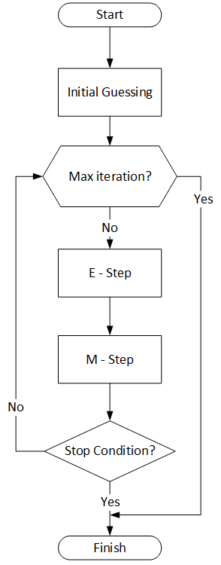
EMA Labs
Getting Started
Setting up the first case
Step 1: Reading CSV
Step 2: One Hot Encoding of Machine Steps
Step 3: Preprocessing: Lot Information
Step 4: Preprocessing: Machine Information
Step 5: Running EM Algorithm
Step 6: Saving Report
Experiment on Real Data (bigger dataset)
Notes:
CREATE A NAVIGATION!

Slide 6
Getting Started
Prerequisite:
Internet and browser (to open google colab)
Or using offline IDE
Python 3.6+,
Python IDE (Pycharm, Spyder, or similar)
Code configuration:
RAWDATA_CSV_PATH_FILENAME: specify the filename which will be analyzed
REPORT_PATH_FILENAME: specify the output filename
MAX_EMA_ITERATIONS: specify the maximum iterations
Notes:
CREATE A NAVIGATION!

Slide 7
SIMPLIFIED CASE

Slide 8
Setting up the first case (page 1)
First you need to copy these files into your google drive:
custom_utility.py
real_world_data.csv
test_case_1a.csv
Yield rate estimation Lab.ipynb
And remove the word “Copy of” from each of these files
Then move these file into a Folder in your google drive, e.g. EMLab
Open the Yield rate estimation Lab.ipynb file in the Google colab

Slide 9
Setting up the first case (page 2)
Go to “Initializing Google Colab” section and change "ColabNotebook/TH" with your folder path in your google drive (e.g. EMLab)
cd 'gdrive/My Drive/ColabNotebook/TH'
In the “Code Configurations” section, modify the setting variable such as:
Find RAWDATA_CSV_PATH_FILENAME and insert the value with our simplified raw data ‘test_case_1a.csv’
Find REPORT_PATH_FILENAME and insert the value with ‘report_test_case_1a.csv’
(optional) You can also change the maximum iteration of EM Algorithm in MAX_EMA_ITERATIONS value with any integer number (between 10 to 50 is recommended)

Slide 10
Setting up the first case (page 2)
Then click Runtime menu > Run All
Then it will stop in “Initializing Google Colab” section,
Go to the provided URL and get the authorization code from that URL
Then paste in the “Enter your authorization code:” box
Later, you got error on the “Run EM Algorithm v1.2” section, which you need to complete the code from the following slides

Slide 11
Step 1: Reading CSV
First, find the main function to run the EM functions, like if __name__ == "__main__":, usually in the bottom of the script.
The beginning of our analysis start from loading the data. So you can call the read_csv_files function with our raw data.
raw_data = read_csv_files(source_filename)
Then you can check your loaded data
print(raw_data.head())

Slide 12
Step 2: One Hot Encoding of Machine Steps
Next, we need to create one hot encoding for each machine step and add lot machine usage to raw_data
Call the get_onehot_machine function with the parameter of our loaded raw data.
onehot_lot_last_step, machine_information, raw_data = get_onehot_machine(raw_data)
This function returns hot encoding data including machine name and updated raw data.

Slide 13
Step 3: Preprocessing: Lot Information
Next, we need to calculate each LOT's statistics
Call the get_lot_information function with the parameter of our updated raw data.
lot_information = get_lot_information(raw_data)
This function will read the statistic of each lot in given source dataframe.

Slide 14
Step 4: Preprocessing: Machine Information
Next, we need to calculate each machine's statistics
Call the get_machine_information function with the parameter of our new variables.
machine_information = get_machine_information(onehot_lot_last_step, machine_information, lot_information)
This function will calculate the statistic of each machine from several related sources.

Slide 15
Step 5: Running EM Algorithm
Here, we already have the data required by our EM algorithm function. So we can start analyzing our data.
Call the em_algorithm function with the parameter of our new variables.
machine_information, em_iter_res, iters = em_algorithm(raw_data, machine_information, lot_information)
This function will calculate machine's yield rate using EM Algorithm.

Slide 16
Step 6: Saving Report
The last thing to do is, saving our result to the CSV file using create_report function:
report = create_report(machine_information, report_filename)
Then you can check your newly created file.

Slide 17
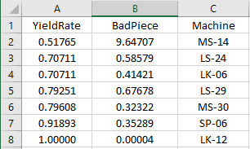
The Result
The result is already sorted ascendingly.
So the lowest yield rate is in the top list.
Different computer or IDE may show a slight different result, but should be close to this

Slide 18
REAL CASE

Slide 19
Setting up the real case
Now if you have no trouble in previous case, you can start analyzing the real data with the bigger dataset. Then report your result.
First you have to open the em_algorithm_v1_2.py file in the python IDE
Modify the setting variable such as:
Find RAWDATA_CSV_PATH_FILENAME and insert the value with our simplified raw data raw_real_data.csv’
Find REPORT_PATH_FILENAME and insert the value with ‘report_real_case.csv’
(optional) You can also change the maximum iteration of EM Algorithm, just change MAX_EMA_ITERATIONS value with any integer number (between 10 to 50 is recommended)
Start analyzing your data using EM Algorithm (similar to simplified case)

